Slide 1
Relating Tuning Properties to Connectivity in Visual Cortical Neurons by Layer, Cre Line and Area
Zhengyu Ma, Alex Gribizis, Phil Parker

Slide 2
The Visual Cortices are Heterogeneous
Different extrastriate visual areas receive distinct types of information from V1
Could we predict a neuron’s layer or area given information about its tuning?
Could a neuron’s tuning properties relate to the extrastriate regions it projects to?
V1 Axons in LM, AL or PM
Harris & Mrsic-Flogel, Nature 2013
Glickfeld et al., Nat. Neuro. 2013

Slide 3
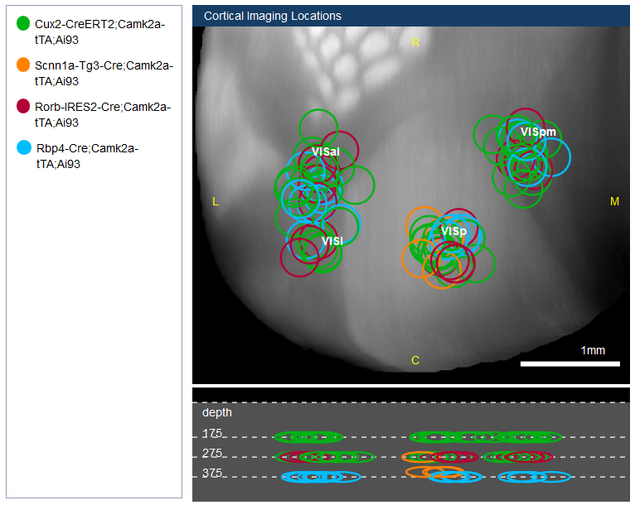
Combining Allen Brain Observatory and Connectivity Data Could Provide Some Answers
Compare projections from different V1 layers (using Cre lines) to extrastriate regions using the Connectivity Atlas
Classify V1 neurons based on receptive field tuning properties using the same Cre lines
Are the tuning properties of extrastriate regions related to the tuning of their V1 inputs?
brain-map.org

Slide 4
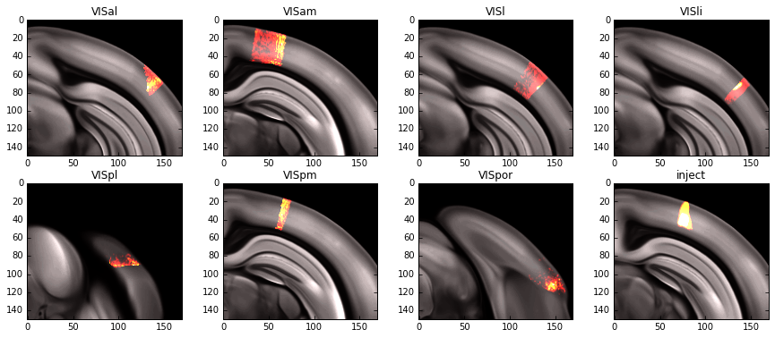
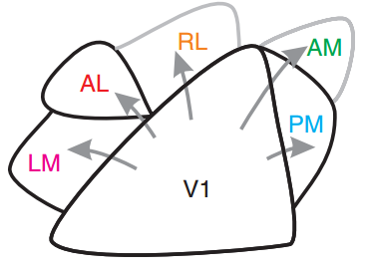
Connectivity Measurement Criteria
Projection
Density
Background Density
Injection Density
Density = sum pixels/structure volume

Slide 5
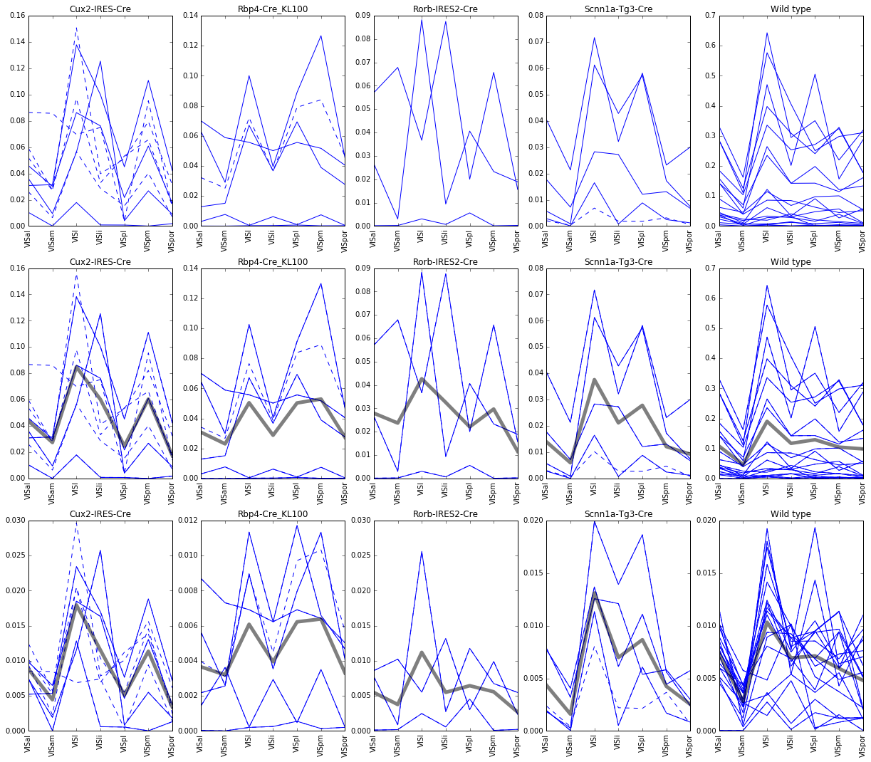
Comparing Normalization Methods
Proj Density
Proj/Inj Density
Proj/(Inj+Bkgnd)

Slide 6
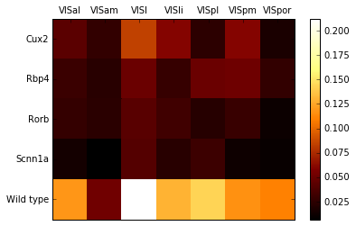
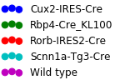
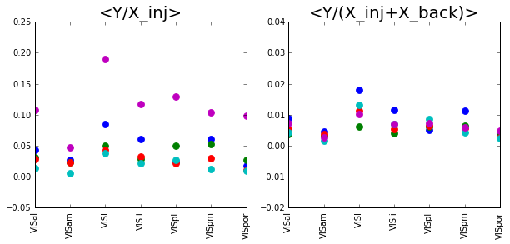
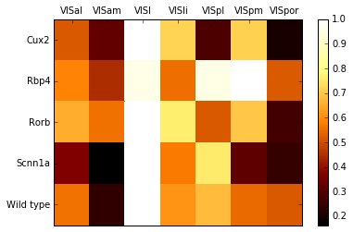
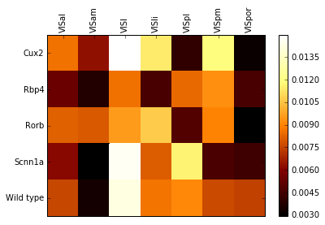
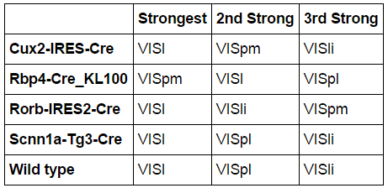
Differential Projection Strengths across Cre Lines
Proj/(Inj+Bkgnd)
Proj/Inj Density
Proj/Inj Density
Normalized Proj/Inj Density
Proj/(Inj+Bkgnd)

Slide 7
Connectivity Summary
Rbp4-Cre V1 neurons preferentially target PM
Cux2, Rorb, and Scnn1a-Cre neurons preferentially target LM
This suggests:
V1 L2/3/4 neurons preferentially target LM (ventral stream?)
V1 L5 neurons preferentially target PM (dorsal stream?)
Is this preferential targeting of extrastriate regions related to the tuning properties of these neurons?

Slide 8
Brain Observatory Feature and Cell Selection Criteria
What receptive field tuning properties are ideal to use for cell classification?
Direction & orientation circular variance, spatial frequency, temporal frequency, time to peak
What criteria should we use to select “responsive” cells?
Filter out suppressed by contrast cells
Select minimum value for ΔF/F peak response (3%)
Cells must have both Session A & B data

Slide 9
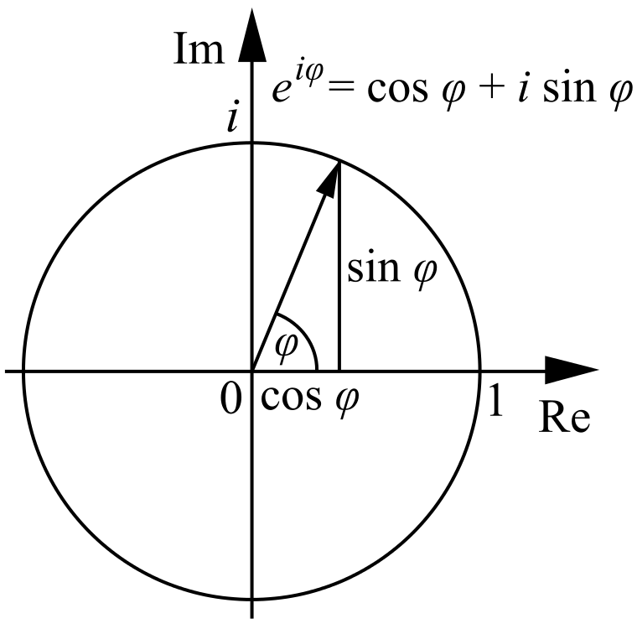
Orientation and Direction Selectivity Measures
df/F
5 - ( -1)
= 1.5
5 + ( -1)

Slide 10
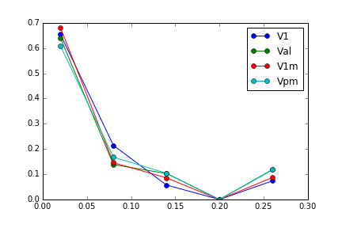
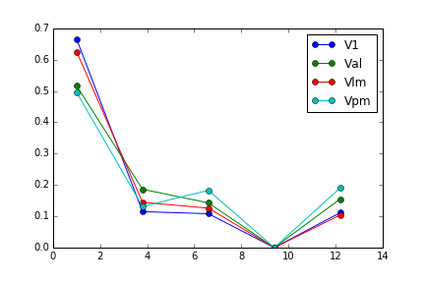
Spatial and Temporal Frequency Tuning is Similar across Visual Areas
Spatial Frequency
Temporal Frequency
Proportion of Cells
Proportion of Cells
Cycles/degree
Hz
V1 Axons in LM, AL or PM
Glickfeld et al., Nat. Neuro. 2013

Slide 11
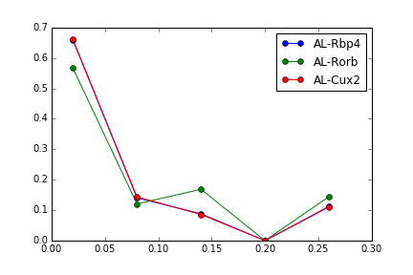
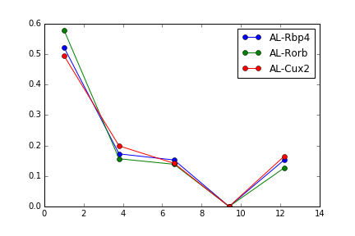
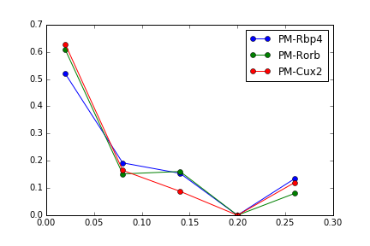
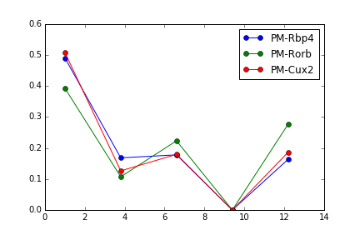
Area and Layer-Specific Tuning Responses Are Not Different between AL and PM
Spatial Frequency
Temporal Frequency
Proportion of Cells
Proportion of Cells
Cycles/degree
Hz
Spatial Frequency
Temporal Frequency
Proportion of Cells
Proportion of Cells
Cycles/degree
Hz

Slide 12
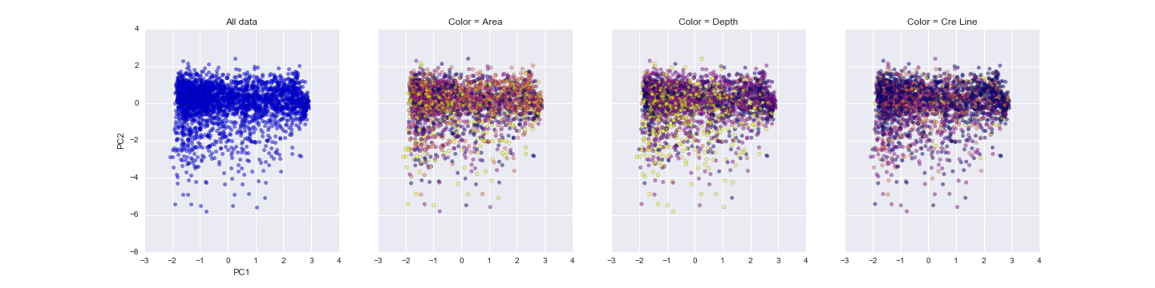
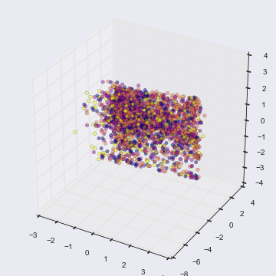
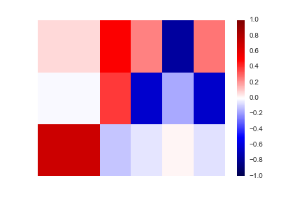
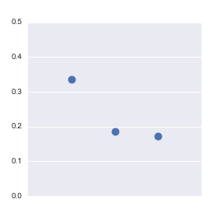
Using PCA to Look for Evidence of Clustering
dOriCV
dDirCV
sOriCV
tPeak
SF
TF
PC1
Explained Variance
PC2
Components
PC3
PC1
PC2
PC3

Slide 13
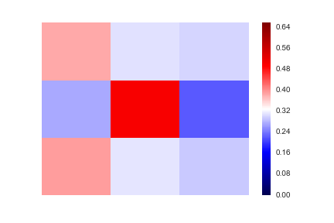
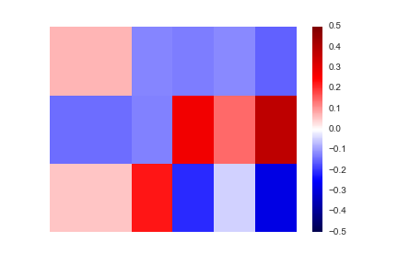
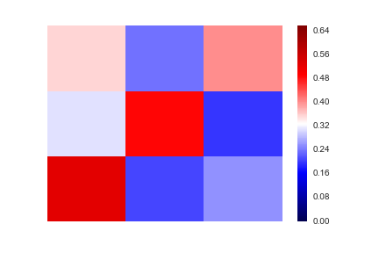
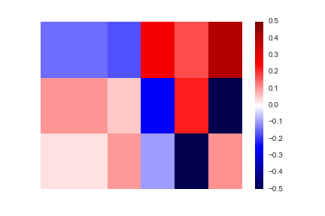
Logistic Regression Classification for Cre Line or Depth
Confusion Matrix!
Regression Coefficients
Rorb
Rbp4
Cux2
dOriCV
dDirCV
sOriCV
tPeak
SF
TF
Cux2
Cux2
Cre Line
Rbp4
Labeled/total cells per line
Rbp4
Coefficients
Rorb
Rorb
375um
275um
175um
dOriCV
dDirCV
sOriCV
tPeak
SF
TF
175um
175um
Depth
275um
Labeled/total cells per line
275um
Coefficients
375um
375um

Slide 14
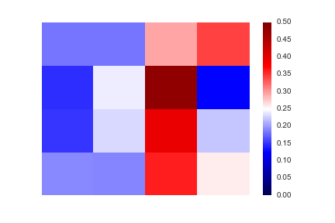
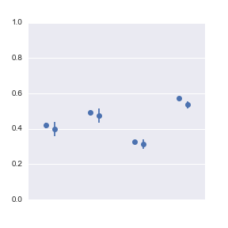
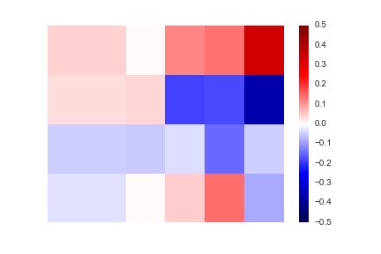
Logistic Regression Classification for Visual Area
AL
LM
V1
PM
PM
Classifier Performance
V1
Visual Area
Labeled Cells/Area
LM
AL
Train/Test Score
dOriCV
dDirCV
sOriCV
tPeak
SF
TF
PM
V1
Visual Area
Coefficients
Cre Line
Depth
Vis Area
LM
D/V Stream
AL

Slide 15
Brain Observatory Summary
Classification was mostly better than chance but not great
Better clustering algorithms? More data?
Brain Observatory data do not entirely recapitulate findings in the literature
PM and AL spatial and temporal frequency tuning not consistent with previous findings
Orientation/direction tuning across layers is surprisingly similar

Slide 16
Combining Connectivity and Brain Observatory Findings
Time to peak explains much of classification coefficients
Positively weighted for Layer 5 and PM
Negatively weighted for Layer 2/3/4 and LM
Projections from specific V1 layers preferentially target different regions
Layer 5 projects to PM
Layers 2/3/4 project to LM
What does it mean?

Slide 17
Potential Model
Anatomical connectivity explains time to peak differences for L5 and PM
L4 output to LM and L2/3 is concurrent
Is L5 comparing information from L2/3 and LM?
Is top-down information arriving in V1 earlier than one might expect?
Harris & Mrsic-Flogel, Nature 2013

Slide 18
Future Directions
Inhibit individual extrastriate regions and look for effects on V1 response properties and encoding
e.g., does LM inhibition alter L5 responses?
Record simultaneously from V1 and extrastriate regions
Difficult but possible, especially at border areas
What is the layer specificity of connections between V1 and extrastriate regions?
Accounting for variability in tuning measures
Tweaking early analyses to improve cell extraction and reduce response spillover between trials?

Slide 19








Thank you!

